Slide 1
Classifying weather data with backpropagation
By: Edward Chen and Shiva Ramamurthi

Slide 2
Introduction
Data acquired from NCDC (National Climate Data Center)
Dataset contains weather stations throughout the US that recorded maximum temperature, minimum temperature, and precipitation for the year 2000.
Our goal is to categorize east and west weather stations based off max temperature, min temperature, and precipitation.
The following map will indicate the divide between east and west.

Slide 3
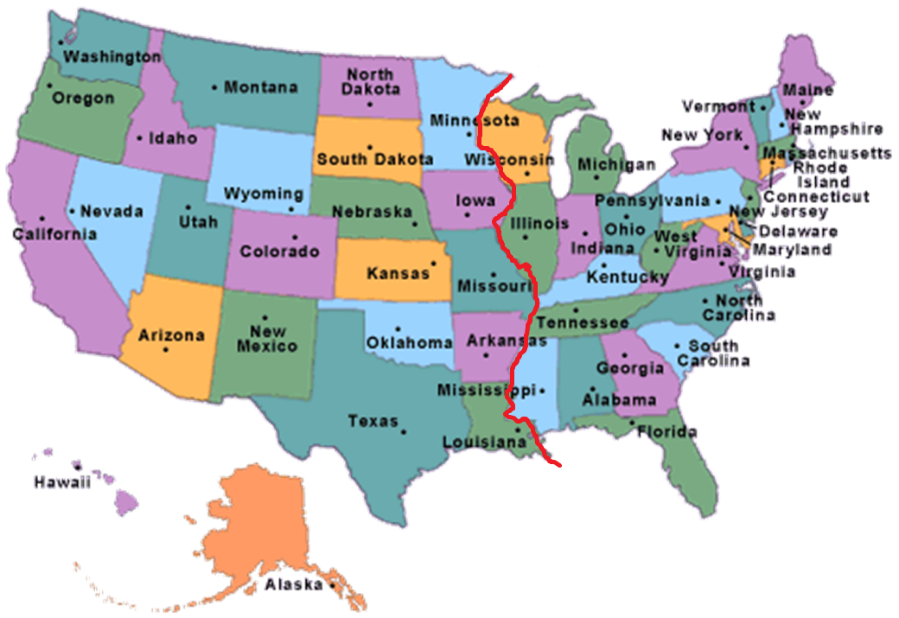

Slide 4
Reading Data
Data contains approximately 6000 weather stations and each stations maximum temperature, minimum temperature, and precipitation values for January, 2000.
Some stations were missing so we had to parse through all the lists to make sure each list had the same dimensions
In order to make sure the 3 variables had the same dimensions, we wrote a c++ program to solve this problem.

Slide 5
Why Backpropogation?
To answer the credit assignment problem that would be caused by the other neural networks we know
Credit Assignment Problem basically states that if the network gives a correct output, the user does not know which weights contributed
Better than linear associator model because linear associator breaks down with large dimensionalities and we’re dealing with big data
Linear associators are better suited for linearity but weather is nonlinear
You can see how the linear associator broke down in the homeworks when we started to input higher dimensions

Slide 6
Discussing the Code
Talk about what we’re inputting and outputting
How we presented the data in terms of rows and columns
Why we vertcat the rows
Why we zscore
Three weights for input layer, two for hidden and one for output
Output is binary response, with 1 == West and 0 == East
Talk about you can see the trend of similar weather but given our limited variables, it would be too hard to distinguish which station is on the east or west coast
Average around 40 epochs to get a SSE less than 0.01

Slide 7
Limitations of Backpropagation
For real world data, principal components analysis is more efficient because there are a lot of flat spots on the error surface and it may be hard for backpropagation to find the global minimum
Principal components scans through the data and finds the eigenvectors
Breaks when the input is information it is not trained on
Based on the assumption that minimizing error is the right thing to do
Depending on what error is defined as, minimizing may not be the best solution
Backpropagation scales poorly, the learning times are extremely long
When inputting new training sets into a trained system, the learning times are really long because all the old connections are changing to accommodate the new information
In terms of neural networks, not biological learning
Widrow-Hoff has close ties to some kinds of biological learning

Slide 8
Possible ways to expand project
Adding in the data for all the months instead of just January or all the years instead of just the year 2000 will allow the system to extrapolate patterns better
However, this would take a really long time with all the training sets
If we included more variables besides the maximum temperature, minimum temperature and precipitation

Slide 9
Explain experiment and topic
why did we use backprop
Advantages and limitations of backprop and how it breaks
Reasons not to use linear associator
Ways to expand project
Input/output
Talk about our data set and what we did with it
Hidden layer not specific to backprop

